Slide 1
Docker
developer, testing and DevOps perspectives
Dina Berry
Nov 14, 2019

Slide 2
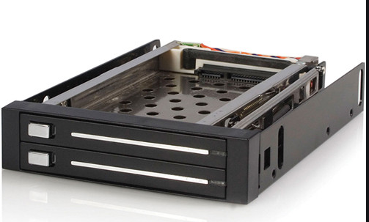
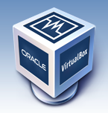

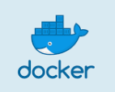
My experience
Needed a highly reproducible environment
Install and test software
Run automation framework
Swappable hard drives – Full OS with UI
Virtual box and ISO files – Full OS with UI
Virtual VMs
Linux
Vagrant – OS
Docker – OS
Notes:
Needed a highly reproducible environment
Swappable hard drives -
Pros –
Reproducible
Easy process – just reset hard drive
Cons –
Hardware dependent
Wear and tear on hardware
Especially mechanism to lock hard drive into place
Time consuming
New install every time
Then apply updates – time consuming
Reset software to last known good was only as good as the reset software
Virtual box and ISO files -
Pros
it worked with Windows, Mac, and Linux legally
It provided full UI and allowed mouse, keyboard, audio, CD drive, network
Cons
Massive memory and hard drive space on host computer
Virtual box was sometimes buggy
Virtual VMs
Linux
Some version of linux because it is free and well-known
Huge ecosystem of tools, people, experience
Vagrant
one form
lost favor in recent years
In my opinion, not as easy as docker
Docker
Generally the winner

Slide 3
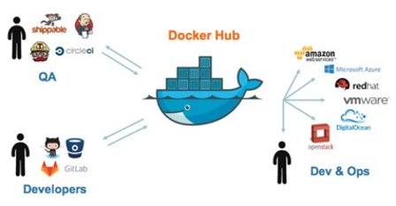
Why containerized VMs?
Open source
Enterprise support and tooling
Single environment for everyone
Simple asset management
Easy to use
Easy to add into ecosystem
Supported by ecosystem tooling
Notes:
Open source
Ignoring some OSS drama and just sticking with term of “open source”
Community edition is free
Strong stackoverflow community for questions and answers
Enterprise support and tooling
Paid option
New paid features roll out
Single environment for everyone
Same docker file should run the same everywhere
-ish (not 100% true but more like 95% true)
Simple asset management
Easily shared, extended, improved, and configured
DockerFile - just a text file and a CLI
Easy to use
CLI for most situations
DockerHub (a manager for dockerfiles) for
source of truth versions from manufactuers such as Microsoft for .Net Core
1 offs
Experiments
Private containers
OS configurations via
Environment variables
system configuration in Dockerfile
Usual suspects of script files run as part of docker building container
Easy to add into ecosystem
Create private network of containers – access with user and password in usual manner
Create network with only one container accessible such as website and database
Create cluster of same containers such as 3 mongo databases with failover and redundancy
Create full network of single purpose containers that fullfil larger purpose
Supported by ecosystem tooling
Kubernetes uses docker containers to provide ecosystem definition and management
Docker Compose provides the same idea of an ecosystem definition and management

Slide 4
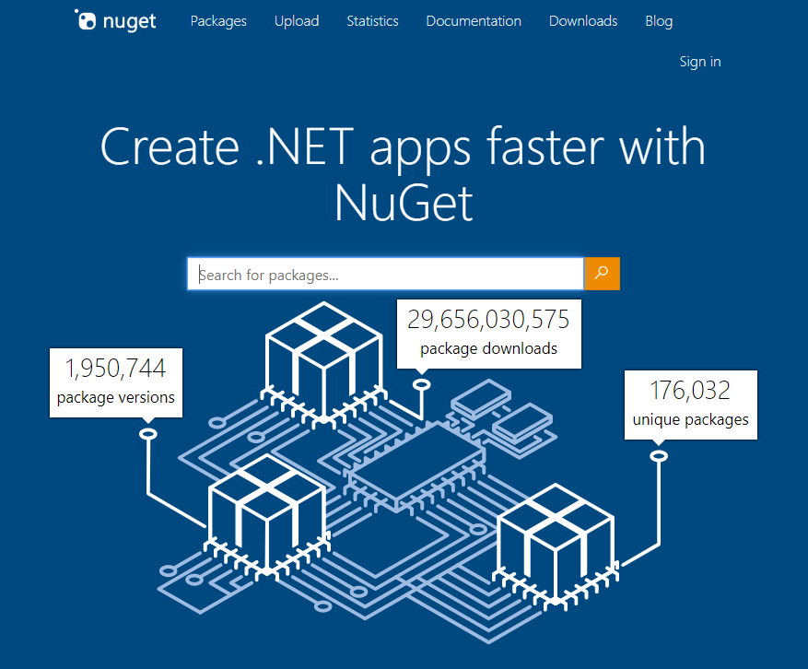
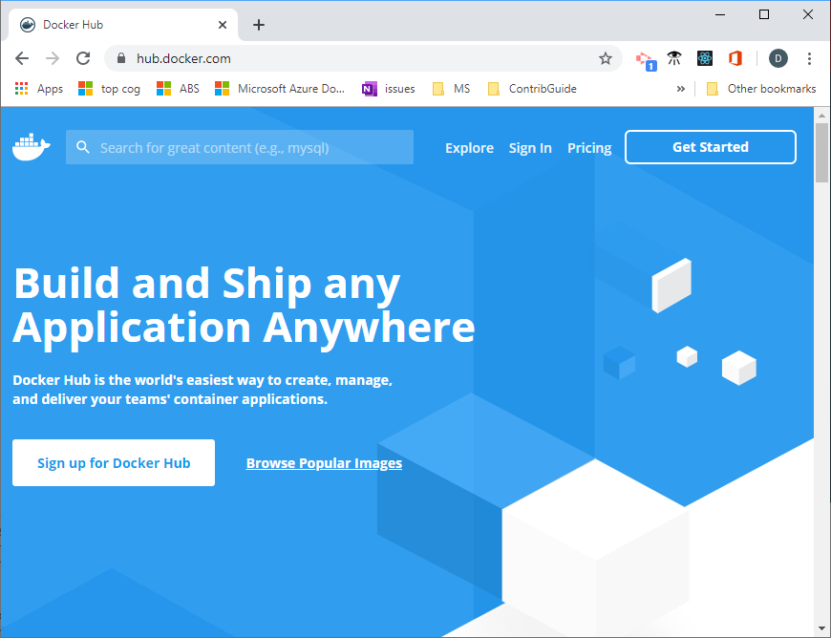
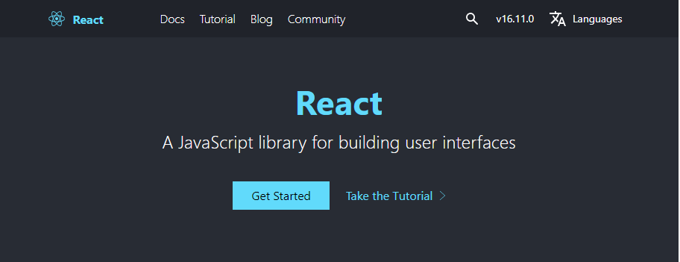
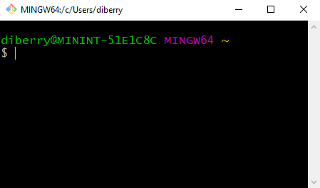
Docker for Devs
Easy to find base image
Single source of truth for running code
Fits in tooling strategy
Great for wide variety of projects
Live debug of container
Log into container and work from there
Notes:
Easy to find base image
Dockerhub has many exampless
Provides a great search tool
Single source of truth for running code
Same source across operating system
Same source for dev, test, pipelines, and production
Fits in tooling strategy
Text file checked into code repository
Portable and secure
Great for a wide variety of projects
Main access is through command line/ terminal or browser
CLI
Library or package
Web site or web app
Can create traditional UI but is more advanced and not the target project
Live debug
Treated as either another remote host or access through browser/port
Log into container as work from command line there
Install, configure, retry, check state, check logs

Slide 5

Docker for Test and DevOps
Local machine
Network
Cloud
Isolated
Reproducible
Automatable
Connected
Notes:
Tests are usually already meant for automation.
Docker container is already networked so it can log out to other systems

Slide 6
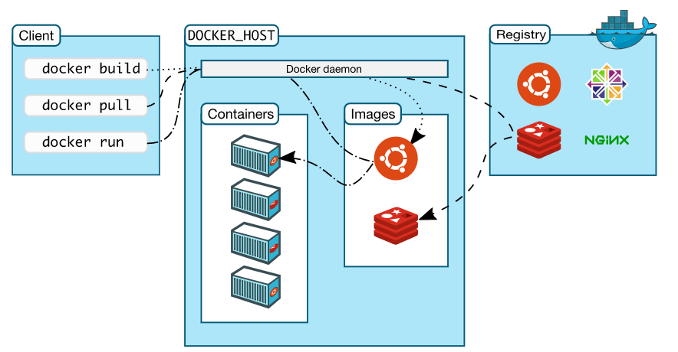
Using Docker

Slide 7
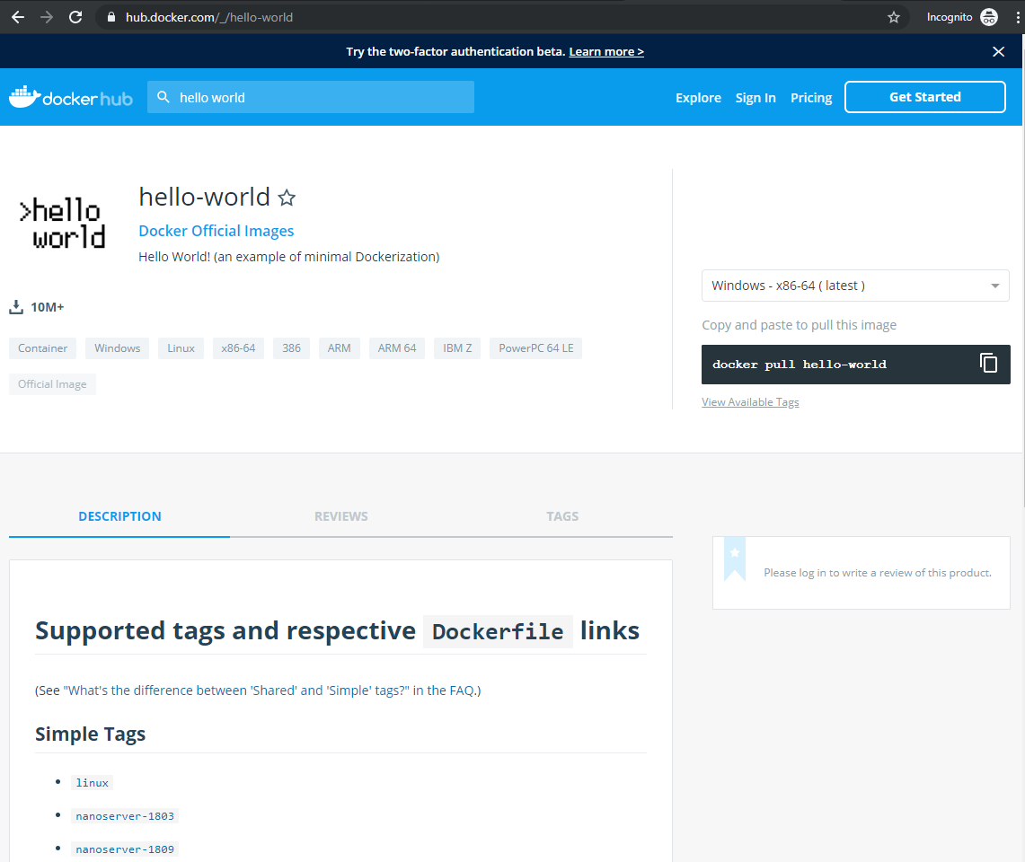
Docker hub
Notes:
Information about the docker file, including:
Tags, which are used for versioning but are better because it is a string so it can include the name, version number, os
Like NPM or NuGet – a package manager

Slide 8
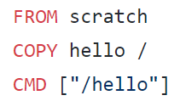
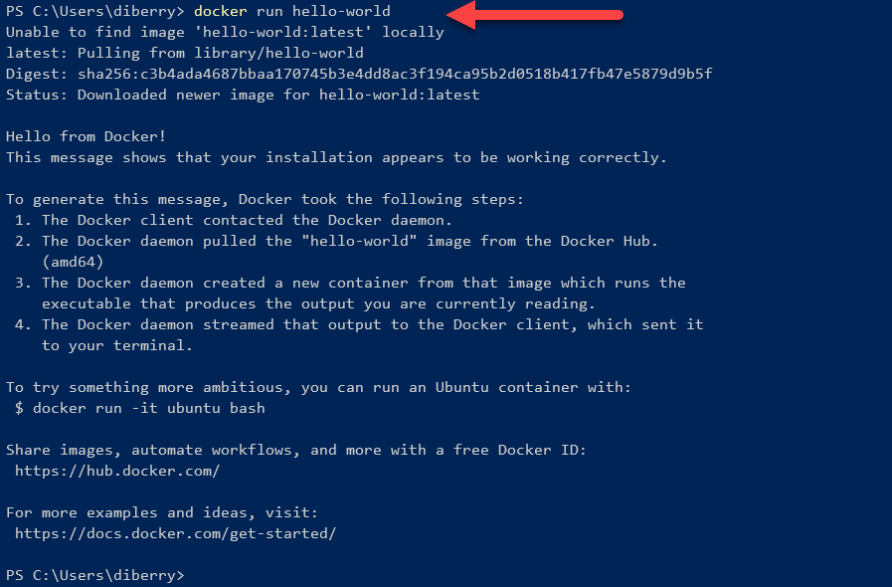
Dockerfile
Notes:
Docker file
Words in red indicate docker commands
From indicates where the image for the container comes from
COPY indicates copying something from host to container
CLI
Docker pull looks a lot like git pull
Docker images filtered to just hello-world
Operating System is linux for containers in this presentation

Slide 9
How should you run the container
Detached vs foreground
Exit vs forever
Notes:
Detached means docker is no longer listening to the command line where `docker run` was run. Good for containers you don’t need to interact with, such as a test or build system. Detached with –rm means the container is removed when the process ends. This is a good clean up technique.
Foreground means the command line is still actively listening and can report logged – for example. This is good for development environments where you want to see the logging such as a backend web server’s logs.
Exit – container stops running when it is done
Forever – container continues until stopped

Slide 10
Demo 1 – add 2 numbers
Script with inputs and outputs
Used in automation and continuous processes
FROM node
COPY . /usr/src
WORKDIR /usr/src
RUN npm install
CMD ["node", "index.js"]
docker build -t demo1 .
docker run --rm -e "FIRST=2" -e "SECOND=3" demo1
docker run --rm -e "FIRST=10" -e "SECOND=30" demo1

Slide 11
Networked containers
Typical network configurations but with containers
Example - proxy
Web server farm
DB server farm
Configured with text files and CLIs
Management toolsets include
Docker Compose
Kubernetes
Others

Slide 12
Demo 2 – web UI to db
2 containers with docker-compose
Web UI
MySql db
Only Web UI is exposed
DB exists as long as container exists
Uses port exposed by container
http://localhost:8080/?server=db&username=root

Slide 13
Demo 3 – VSCode in browser
1 container
Modified with
.Net Core
Node.js
Java
Python
Go
Azure CLI
Cognitive Services Quickstarts
Run quickstart in VSCode IDE
Add key & endpoint
Run quickstart
Manage resources with Azure CLI
https://localhost:8443/

Slide 14
Containers on Azure
Azure Container Registry
Private
Equivalent to DockerHub
Azure web app
Run from image
Azure Container Instance
Easy
Expensive
Azure Kubernetes Service
Hard
Less expensive

Slide 15
Microsoft Containers
Windows Server Core
.Net Core
Azure SQL
Azure Functions
Azure IIS
Azure IoT Edge
Azure Cognitive Services
Many ML and AI-based containers
Azure CLI
Azure Pipelines
Powershell
And many more…

Slide 16
How can DevRel use containers?
Automate tasks that require
Time to install and configure
Expertise or regular familiarity to use
Use base containers that
Designed and maintained by SME
Develop specific containers
Reduce friction for customer with prerequisites
Focus customer’s learning to task at hand

